Slide 1
Operating System Structure Week - 02
Operating Systems
Instructor: Noreen Khalid

Slide 2
Chapter Outline
Process Management
Memory Management
File Management
I/O System Management
Secondary Storage Management
Networking
System Protection
Operating System Services
OS Layered Approach
OS/2 Layer Structure
Virtual Machines
System Design Goals
Mechanisms and Policies
Operating System Implementation
System Generation (SYSGEN)

Slide 3
OS Service Management

Slide 4
Process Management
A process is a program in execution
A process needs certain resources, including CPU time, memory, files, and I/O devices, to accomplish its task
The operating system is responsible for the following activities in connection with process manager
Process creation and termination
Process suspension and resumption
Provision of mechanisms for:
process synchronization
process communication

Slide 5
Memory Management
Memory is a large array of words or bytes, each with its own address
It is a repository of quickly accessible data shared by the CPU and I/O devices.
Main memory is a volatile storage device
It looses its contents in the case of system failure
The operating system is responsible for the following activities in connections with memory management:
Keep track of which parts of memory are currently being used and by whom
Decide which processes to load when memory space becomes available
Allocate and deallocate memory space as needed

Slide 6
File Management
A file is a collection of related information defined by its creator
Commonly, files represent programs (both source and object forms) and data
The operating system is responsible for the following activities in connections with file management:
File creation and deletion
Directory creation and deletion
Support of primitives for manipulating files and directories
Mapping files onto secondary storage
File backup on stable (nonvolatile) storage media

Slide 7
I/O System Management
Operating system is responsible for I/O system management
The I/O system consists of:
A buffer-caching system
A general device-driver interface
Drivers for specific hardware devices
Buffer-Caching System → Smooth, efficient data transfer.
General Device-Driver Interface → Provides uniform I/O API for applications.
Device Drivers → Translate OS requests into hardware-specific actions.

Slide 8
Secondary Storage Management
Since main memory (primary storage) is volatile and too small to accommodate all data and programs permanently, the computer system must provide secondary storage to back up main memory
Most modern computer systems use disks as the principle on-line storage medium, for both programs and data
The operating system is responsible for the following activities in connection with disk management:
Free space management
Storage allocation
Disk scheduling
Secondary Storage Management by OS includes:
Free space management → Track unused blocks.
Storage allocation → Decide how to store files.
Disk scheduling → Optimize I/O request order.
File system management → Provide structure for data.
Reliability & recovery → Ensure data safety.

Slide 9
Networked System
A networking system is a collection of processors
The processors in the system are connected through a communication network
Communication takes place using a protocol
This system provides user access to various system resources
Access to a shared resource allows:
Computation speed-up
Increased data availability
Enhanced reliability
A networked system = interconnected computers managed by OS to provide:
Communication (sockets, RPCs)
Resource sharing (files, printers, applications)
Security (authentication, encryption)
Fault tolerance (distributed reliability)
Real-Life Examples of Networked Systems
University or Office LAN (Local Area Network)
All computers in labs or offices are connected.
Shared printers, files, and applications across the network.
Example: Student submits assignment from one PC → teacher accesses it on another.
Small-scale examples → University LAN, Office network.
Large-scale examples → Cloud storage, Banking networks, E-commerce, Social media.

Slide 10
System Protection
Protection refers to a mechanism for controlling access by programs, processes, or users to both system and user resources
The protection mechanism must:
distinguish between authorized and unauthorized access
specify the controls to be imposed
provide a means of enforcement
Example 1: University LAN (Local Area Network)
In a university, multiple computers in labs are connected via LAN.
The networked OS allows:
Communication → Students can send messages or submit assignments through a central server.
Resource Sharing → Printers, projectors, and lab software are shared across all PCs.
Security → Only students with valid logins can access lab systems.
Fault Tolerance → If one lab PC crashes, the rest of the network still works.
LAN in a university → small-scale networked system.
Google Drive/Cloud → large-scale, distributed networked system.

Slide 11
Operating System Services

Slide 12
Operating System Services
An Operating System (OS) provides a set of services to users, programs, and hardware to make the system convenient, efficient, and secure. These services act as an interface between the user/programs and the computer hardware.
Major Operating System Services
Program Execution
Load programs into memory and run them.
Handle execution, termination, and errors.
Example: Running MS Word or a Python script.
I/O Operations
Provide simple and uniform access to I/O devices.
Example: Reading from keyboard, writing to a file, printing a document.
File System Manipulation
Create, delete, read, write, and manage files/directories.
Example: Saving a Word document on disk.

Slide 13
Operating System Services
4.Communication
Allow processes to exchange information.
Methods: Shared memory, Message passing, Sockets.
Example: Chat applications (WhatsApp, Messenger).
5.Error Detection
Detect and handle errors in hardware (disk failure, bad memory) and software (invalid memory access).
Example: Blue screen error in Windows, “Segmentation fault” in Linux.
6.Resource Allocation
Manage CPU, memory, and I/O devices among multiple processes.
Example: OS decides which process gets CPU time next.
7.Accounting (Monitoring & Logging)
Keep track of resource usage by users/processes.
Example: How much CPU time a process used, internet data usage.
8.Protection and Security
Control access to resources.
Ensure only authorized users/programs can access files, memory, or devices.
Example: Login authentication, file permissions in Linux .

Slide 14
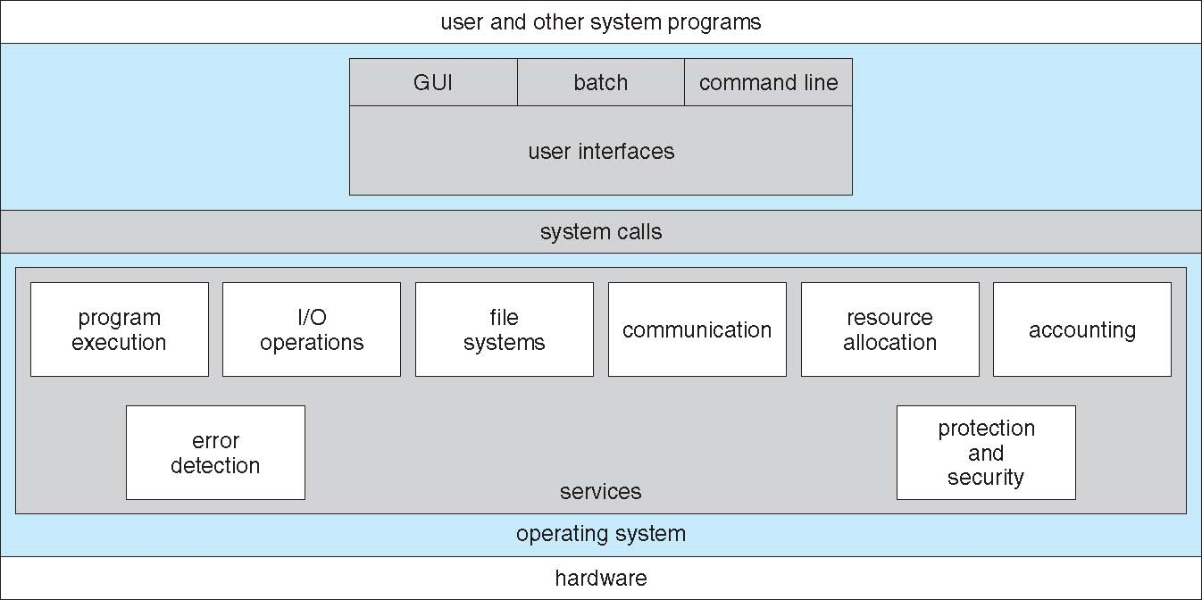
A View of Operating System Services

Slide 15
System Programs
System programs are utility programs that provide a convenient environment for program development and execution. They sit above the OS kernel and below the application software.
They can be divided into:
File manipulation
Status information sometimes stored in a File modification
Programming language support
Program loading and execution
Communications
Background services
Most users’ view of the operation system is defined by system programs, not the actual system calls
They are helper programs that make the OS more useful for both users and developers.

Slide 16
System Programs
Types of System Programs
File Management Programs
Create, delete, read, write, copy, and move files.
Example: Windows Explorer, Linux cp, mv, rm.
Status Information Programs
Provide system info, performance, and resource usage.
Example: Task Manager in Windows, top or uptime in Linux.
File Modification Programs
Edit or modify file content.
Example: Notepad, nano, vim.
Programming Language Support
Compilers, assemblers, interpreters.
Example: GCC (C compiler), Python interpreter.
Program Loading and Execution
Load programs into memory and run them.
Example: ./a.out in Linux, double-clicking .exe in Windows.

Slide 17
System Programs
Communication Programs
Enable communication between processes or users.
Example: Email client, chat applications, ssh.
Application Support
Provide common functions for apps.
Example: Database engines, window systems.
Examples of System Programs (Real Life)
Windows → Notepad, Task Manager, Explorer, CMD.
Linux/Unix → vi, gcc, bash, ls, top.
System programs = "Helper utilities" provided by the OS for file handling, program development, system status, and user interaction. They make the computer more user-friendly and support both users & developers.

Slide 18
Operating System Design and Implementation

Slide 19
Operating System Design and Implementation
Design and Implementation of OS not “solvable”, but some approaches have proven successful
Internal structure of different Operating Systems can vary widely
Start by defining goals and specifications
Affected by choice of hardware, type of system
User goals and System goals

Slide 20
OS Design Goals
User goals
System goals
Operating system should be
convenient to use
easy to learn
reliable
safe
fast
Operating system should be
easy to design
implement
maintain
flexible
reliable
error-free
efficient

Slide 21
Operating System Design and Implementation
Important principle to separate
Policy: What will be done?
Mechanism: How to do it?
Mechanisms determine how to do something, policies decide what will be done
The separation of policy from mechanism is a very important principle, it allows maximum flexibility if policy decisions are to be changed later
Specifying and designing OS is highly creative task of software engineering

Slide 22
Operating System Implementation
Much variation
Early OSes in assembly language
Then system programming languages like Algol, PL/1
Now C, C++
Actually usually a mix of languages
Lowest levels in assembly
Main body in C
Systems programs in C, C++, scripting languages like PERL, Python, shell scripts
Code written in a high-level language:
can be written faster
is more compact
is easier to understand and debug
An operating system is far easier to port (move to some other hardware) if it is written in a high-level language

Slide 23
Operating System Debugging
Debugging is finding and fixing errors, or bugs
OS generates log files containing error information
Core Dump
Failure of an application can generate core dump file capturing memory of the process
Crash Dump
Operating system failure can generate crash dump file containing kernel memory
Beyond crashes, performance tuning can optimize system performance
Sometimes using trace listings of activities, recorded for analysis
Profiling is periodic sampling of instruction pointer to look for statistical trends

Slide 24
Operating System Generation (SYSGEN)
Operating systems are designed to run on any of a class of machines
the system must be configured for each specific computer site
SYSGEN program obtains information concerning the specific configuration of the hardware system
Used to build system-specific compiled kernel or system-tuned
Can generate more efficient code than one general kernel

Slide 25
System Boot
What is Booting?
Booting = The process of starting a computer and loading the operating system into memory (RAM).
It happens every time you power on or restart your computer.
Types of Booting
Cold Boot → Starting the computer after power is completely off.
Warm Boot → Restarting the computer without turning off power (e.g., pressing Restart).
Real-Life Examples
Windows PC → Press power button → BIOS runs → Bootloader loads Windows kernel → Login screen.
Linux → BIOS → GRUB → Linux kernel → shell/desktop environment.
Smartphones → Boot ROM → bootloader → Android/iOS kernel → home screen.
GRUB is the Linux bootloader that lets you pick an OS, loads the kernel, and helps in recovery/debugging.
System Boot = The step-by-step process of turning on a computer, running BIOS/UEFI, loading the bootloader, kernel, and finally the operating system.

Slide 26
OS User Interface

Slide 27
Compare GUI, Batch, and CLI
Feature | GUI (Graphical) | CLI (Command Line) | Batch Processing
User Interaction | Through icons, menus, windows | Through text commands | No direct interaction (jobs submitted)
Ease of Use | Very easy, beginner-friendly | Harder, requires learning commands | Easy for repetitive jobs, but not interactive
Speed | Slower than CLI | Faster for experts | Efficient for large repetitive tasks
Resource Usage | High (needs CPU & memory for GUI) | Low | Medium
Examples | Windows, macOS, Android | Linux Terminal, MS-DOS, PowerShell | Cron jobs, Windows batch files (.bat)
GUI = Easy, visual (ATM, smartphones, desktops).
CLI = Text-based, powerful (CMD (Type dir in Command Prompt), Linux terminal, networking).
Batch = Automatic, non-interactive (payroll, banking, scheduled backups).

Slide 28
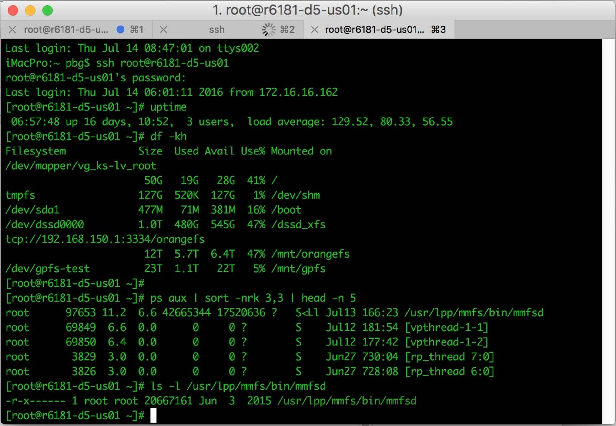
Bourne Shell Command Interpreter

Slide 29
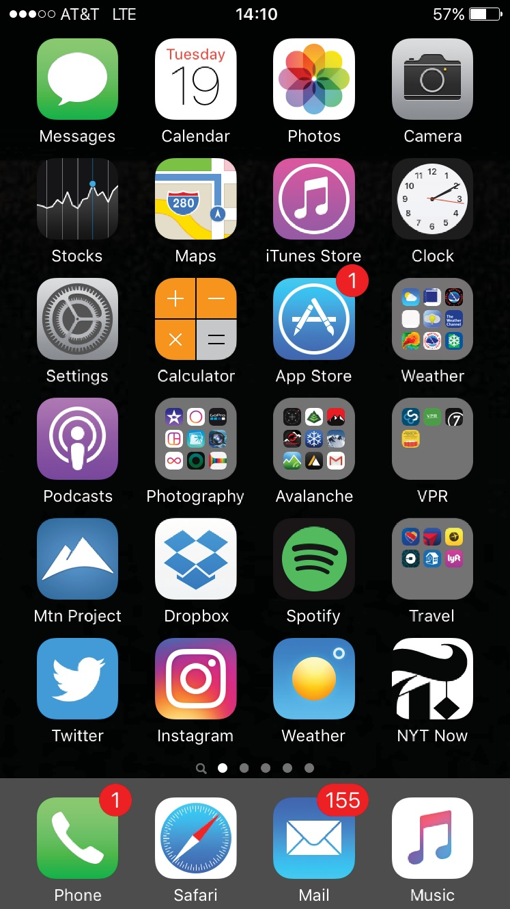
Touch-screen Interface
Touch-screen devices require new interfaces
Mouse not possible or not desired
Actions and selection based on gestures
Virtual keyboard for text entry
Many systems now include both CLI and GUI interfaces
Microsoft Windows is GUI with CLI “command” shell
Apple Mac OS X is “Aqua” GUI interface with UNIX kernel underneath and shells available
Unix and Linux have CLI with optional GUI interfaces (CDE, KDE, GNOME)

Slide 30
Operating System Structure

Slide 31
Operating System Structure
General-purpose OS is very large program
Various ways to structure one as follows

Slide 32
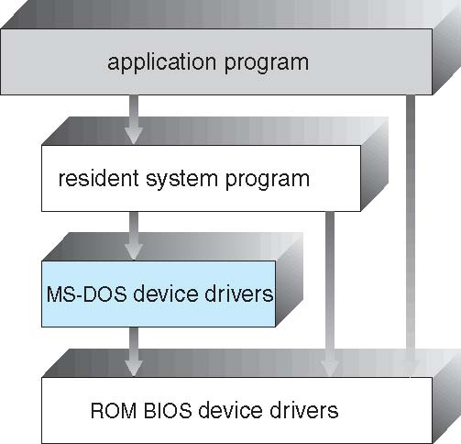
Simple Structure
I.e. MS-DOS – MS-DOS (Microsoft Disk Operating System) is an example of a simple (monolithic) operating system structure.
It was widely used in the 1980s and early 1990s before Windows became popular.
1. Simple Structure
Definition: No proper modular separation; all parts are mixed.
Real Examples:
MS-DOS → All functions like file management, device drivers, system calls bundled together.
Early UNIX (Version 6).
Daily Life Link: Like a small calculator program → everything in one place.
Real-Life Example / Where Used
ATM Machines: Early ATM systems ran lightweight versions of DOS.
Old PCs: Before Windows 95, personal computers booted directly into MS-DOS.
Embedded Systems: Some older industrial control systems and cash registers used MS-DOS due to its simplicity and low resource requirements.
No proper modular separation → everything is mixed.
Example: MS-DOS, early UNIX.
Pros: Easy to design.
Cons: Hard to maintain, less secure.

Slide 33
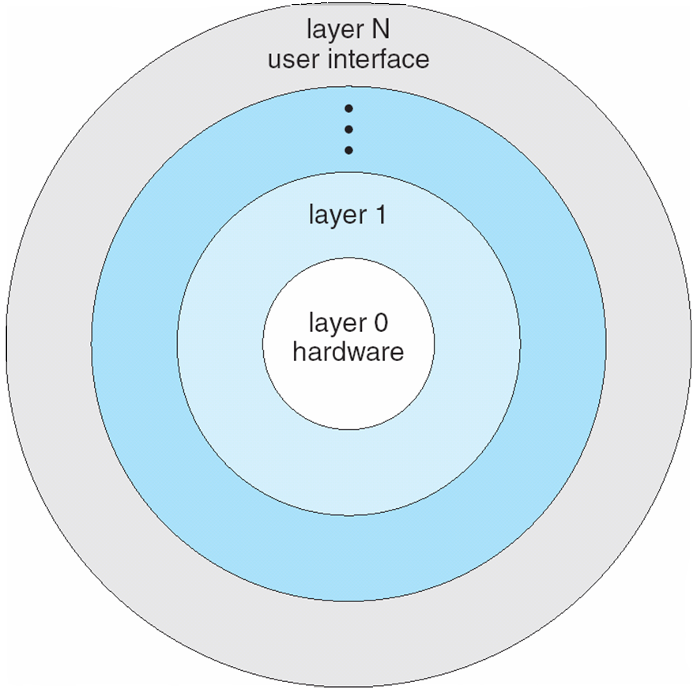
OS Layered Approach
The operating system is divided into a number of layers (levels), each built on top of lower layers
The bottom-most layer (layer 0), is the hardware
The highest (layer N) is the user interface
With modularity, layers are selected such that each uses functions (operations) and services of only lower-level layers
OS is divided into layers, each built on top of the lower one.
Each layer uses services of the layer below it and provides services to the layer above it.
Example: THE OS, early UNIX variants.
Pros: Modularity, easier debugging.
Cons: Overhead from too many layers.
+------------------------+
| User Applications | ← Layer 6
+------------------------+
| System Programs | ← Layer 5
+------------------------+
| I/O Management | ← Layer 4
+------------------------+
| Memory Management | ← Layer 3
+------------------------+
| Process Management | ← Layer 2
+------------------------+
| Hardware | ← Layer 1
+------------------------+
Daily Life Link: Like a cake with layers → each layer builds on the previous one.

Slide 34
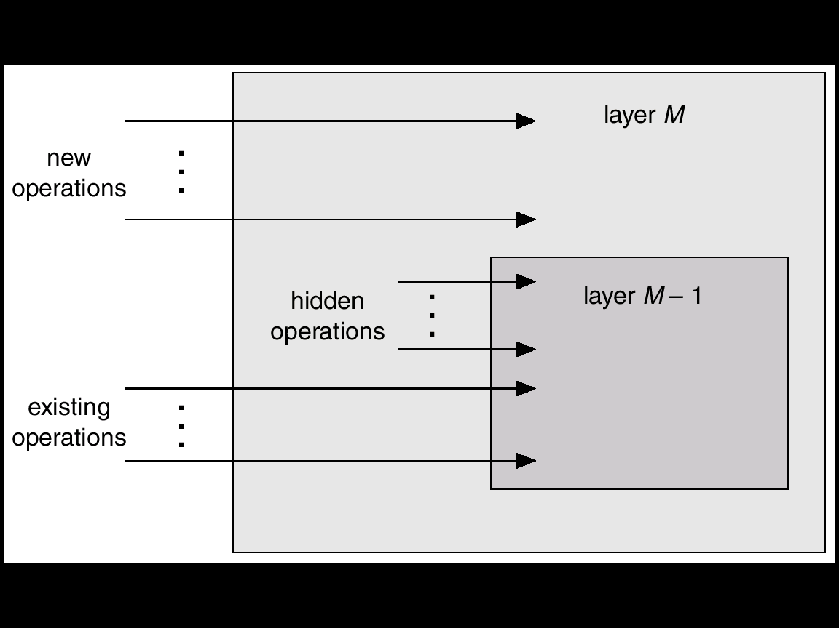
An Operating System Layer
Direction | Meaning
Upward (Layer M → Higher Layers) | Provides new operations or services
Downward (Layer M → Layer M–1) | Uses existing operations provided by the lower layer
Hidden Operations | Internal helper routines invisible to higher layers

Slide 35
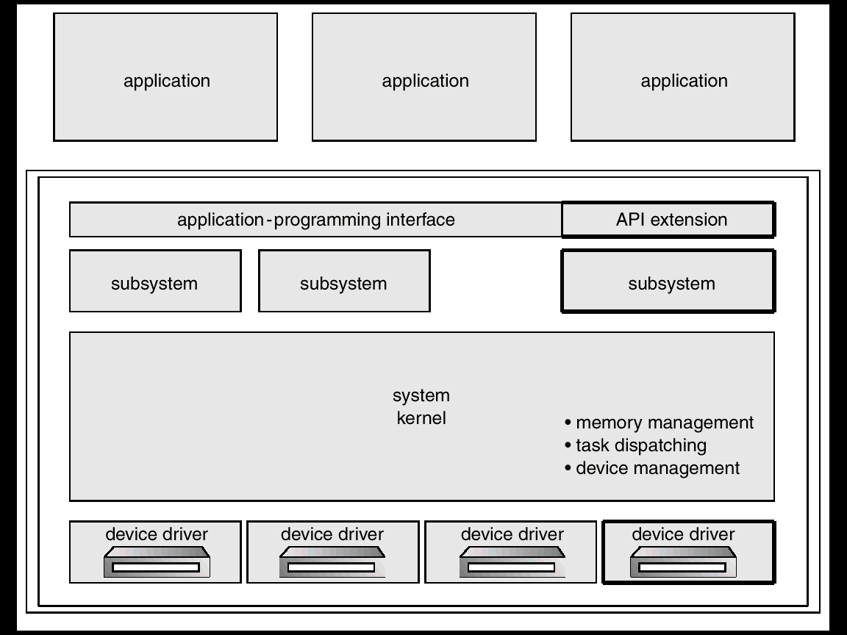
OS/2 Layer Structure

Slide 36
Kernel & Kernel Mode
Kernel is part of operating system that includes most heavily used functions
Generally, kernel is permanently in main memory
Kernel Mode
It is a privileged, nucleus or supervisory mode into which the machine switches when the OS is running
Enables the execution of such privileged instructions
Such as in the area of I/O operations, which are not available to user mode
The techniques by which a user program requests the kernel’s services are;
System calls
Message passing
The process can only be switched into kernel mode by the above actions

Slide 37
Kernel & Kernel Mode
Concept | Meaning
Kernel | Core part of OS managing all hardware and system tasks
Kernel Mode | Privileged execution mode for kernel operations
User Mode | Restricted mode for running user programs
Mode Switch | Happens when a system call is made (User → Kernel → User)
No other way that a user program can execute kernel instructions
This facility is not given to user program in order to enforce system security
User space
User process
Supervisor process
Supervisor
space
Supervisor & user memory

Slide 38
Monolithic Structure – Original UNIX
UNIX – limited by hardware functionality, the original UNIX operating system had limited structuring
The UNIX OS consists of two separable parts
Systems programs
The kernel
Consists of everything below the system-call interface and above the physical hardware
Provides the file system, CPU scheduling, memory management, and other operating-system functions; a large number of functions for one level
Definition: Whole OS runs in kernel mode as one big program.
Real Examples:
Linux (Ubuntu, Fedora, etc.)
UNIX
MS-DOS
Daily Life Link: Like a single big factory where all workers (modules) share the same space → fast but risky if one fails.

Slide 39
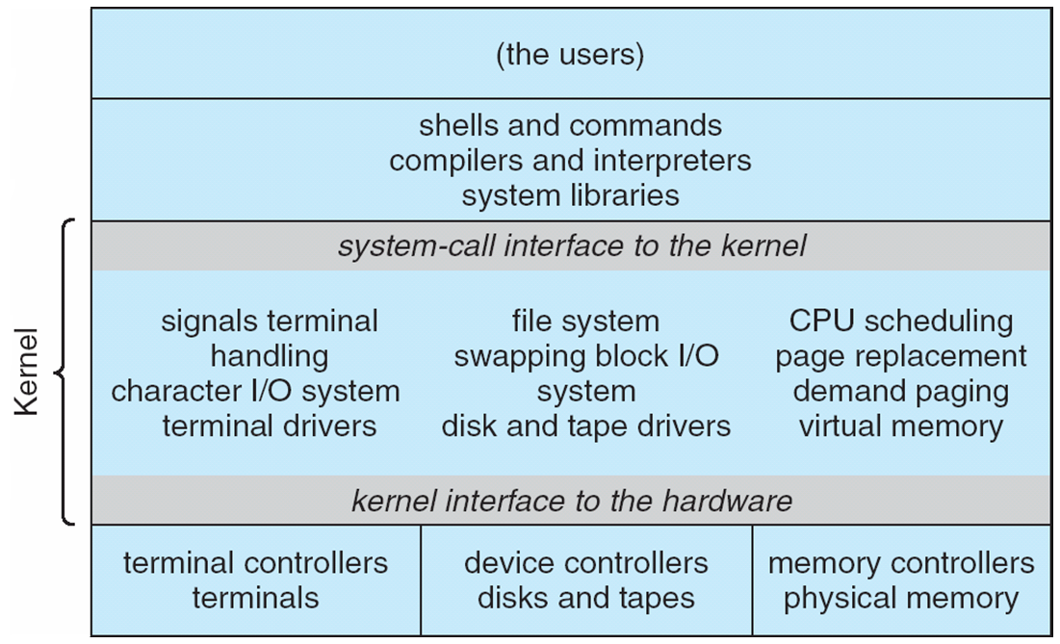
Traditional UNIX System Structure
Beyond simple but not fully layered

Slide 40
Microkernel System Structure
Only essential services (CPU scheduling, memory, inter-process communication) run in kernel.
Other services (drivers, file systems) run in user space.
Example: Minix, QNX, macOS (partially).
Pros: More secure, modular, reliable.
Cons: Slower (extra communication between kernel and user space).
Real Examples:
Minix (educational OS).
QNX (used in cars, medical devices).
macOS/iOS (XNU kernel is hybrid but microkernel-based).
Daily Life Link: Like a company HQ with only managers (kernel) inside → other departments (drivers, file system) in separate offices (user space).

Slide 41
Modules
A module is a separate, independent part of an operating system that performs a specific function. The modular approach means the OS is divided into multiple components (modules), each responsible for a particular task like process management, memory management, I/O, etc.
Each module can be loaded, updated, or replaced independently without affecting the rest of the system.
Most modern operating systems implement loadable kernel modules
Uses object-oriented approach
Each core component is separate
Each talks to the others over known interfaces
Each is loadable as needed within the kernel
Overall, similar to layers but with more flexible
Linux, Solaris, etc

Slide 42
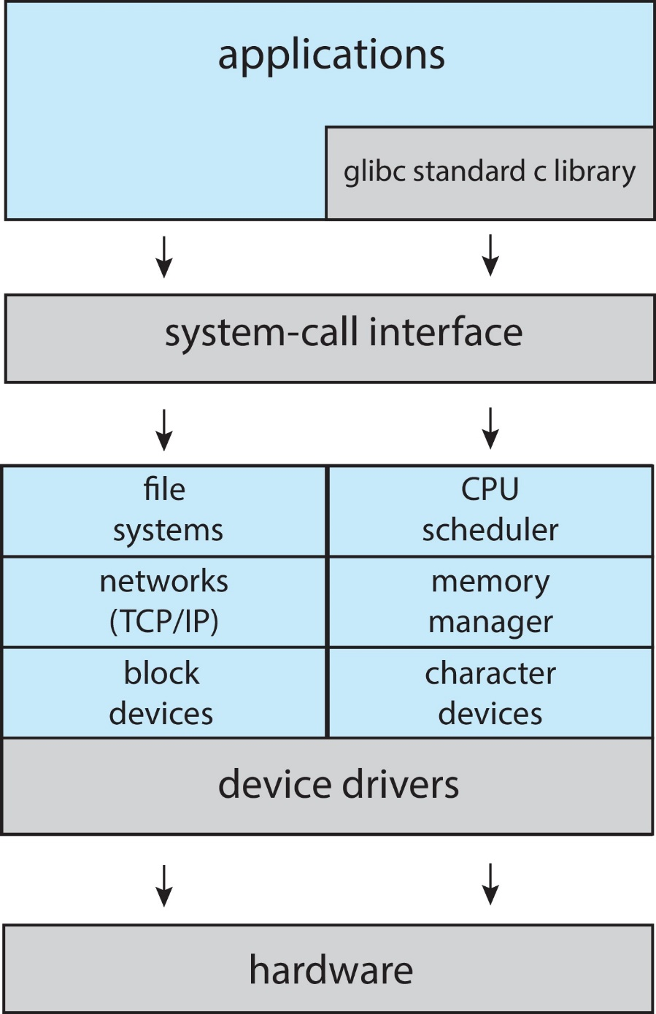
Linux System Structure
Monolithic plus modular design

Slide 43
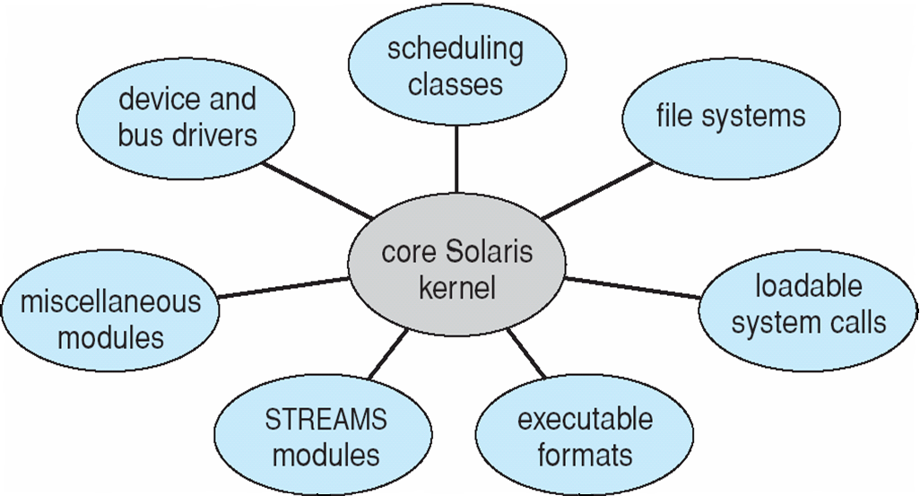
Solaris Modular Approach
Solaris is a UNIX-based operating system originally developed by Sun Microsystems (now owned by Oracle). It uses a modular architecture meaning the system is divided into independent modules, each performing a specific function.
This makes Solaris flexible, scalable, and easy to maintain.
Solaris’s modular structure is designed for large-scale, high-performance, and continuously running systems. It’s widely used in servers, data centers, banking systems, and telecom environments where reliability and flexibility are critical.

Slide 44
Hybrid Systems
A Hybrid System (or Hybrid Kernel) is a type of OS architecture that combines the best features of both:
Monolithic systems (high performance, direct hardware access), and
Microkernel systems (modularity, stability, and security).
In short:
Hybrid = Monolithic + Microkernel + Modular design elements
Example 1 – Windows 10 / 11
Real-life usage: Almost every personal computer, laptop, or enterprise server today.
Example 2 – macOS (XNU Kernel)
Real-life usage: All Apple devices (MacBook, iMac) use this hybrid approach.
Example 3 – iOS
Used in iPhones and iPads — combines real-time responsiveness with system stability.

Slide 45
iOS
iOS is Apple’s mobile operating system used in iPhones, iPads, and iPod Touch. It is derived from macOS (Mac OS X) but optimized for touch interfaces, mobile hardware, and ARM processors.
Real-Life Example
When you open Apple Music on an iPhone:
The Cocoa Touch(UIKit) layer handles touch and UI.
The Media layer plays audio and displays album art.
The Core Services layer connects to iCloud and Apple Music servers.
The Core OS layer manages memory, battery, and audio hardware

Slide 46
Android
Android is an open-source mobile operating system developed by Google for smartphones, tablets, TVs, and wearables. It’s based on a modified Linux kernel and designed mainly for touchscreen devices.
Layer | Description | Example
Applications | User-facing apps | WhatsApp, Instagram
Application Framework | API support for apps | Notification Manager
Android Runtime & Libraries | App execution and core libraries | SQLite, WebKit
Linux Kernel | Hardware management | Camera drivers
Example in Action
When you open your Camera app on an Android phone:
The Application Layer launches the Camera app.
The Framework Layer requests access to the camera service.
The Libraries Layer (Media Framework) processes the image.
The Linux Kernel communicates with the physical camera hardware.
Everything works together seamlessly.

Slide 47
Android Architecture

Slide 48
Virtual Machines
Definition: OS provides an environment where multiple OS instances run on the same hardware.
Real Examples:
VMware Workstation / ESXi
VirtualBox
KVM (Linux Virtualization)
Microsoft Hyper-V
Daily Life Link: Like having separate houses (OS) inside one big building (hardware).
Client-Server Model
Definition: OS divided into client processes (request services) and server processes (provide services).
Real Examples:
Minix (client-server based microkernel OS)
Distributed OS (Amoeba, ChorusOS)
Modern Cloud Systems (Google File System, Hadoop)
Daily Life Link: Like restaurants → client (customer) requests food, server (kitchen) delivers it.

Slide 49
Comparison table with Real Examples
Structure | Definition | Real Examples
Simple | Mixed, no separation | MS-DOS, Early UNIX
Layered | Divided into layers | THE OS, MULTICS
Monolithic Kernel | All in kernel | Linux, UNIX, MS-DOS
Microkernel | Minimal kernel, rest in user space | Minix, QNX, macOS (partly)
Modular/Hybrid | Monolithic + modular | Modern Linux, Windows NT/10/11, macOS
Virtual Machines | Run multiple OS on one hardware | VMware, VirtualBox, Hyper-V
Client-Server | Client requests, server provides | Minix, Amoeba, ChorusOS

Slide 50
System Calls

Slide 51
System Calls
A System Call is a bridge (interface) between:
User programs (applications) ➜ and
Operating System (kernel)
It allows a user program to request services from the OS kernel, such as reading data, writing files, creating processes, or communicating over the network.
Example
When you use a program to save a file:
You click Save in MS Word (user-level request).
Word can’t directly write to the disk (for security reasons).
So, it makes a system call (e.g., write()).
The OS kernel performs the actual disk write operation.

Slide 52
System Calls Example
Compilation Process
To compile a program, a process calls the command interpreter or shell, reads command from the terminal
Shell will create a new process to compile the program
When the process has completed compilation, it executes a system call to terminate itself
Other process system calls are also available to;
Request for more memory
Released unused/extra memory
Process and memory management

Slide 53
System Calls
System calls related to file systems
System calls are needed to create, read, move and write a file
A file should be opened before read it
Similarly, after reading file must be closed which is done by system calls
System calls are required to
create and remove a directory
manipulate file with in different directories
MS-DOS uses software interrupts similar to system calls

Slide 54
System Call Implementation
Typically, a number is associated with each system call
System-call interface maintains a table indexed according to these numbers
The system call interface invokes the intended system call in OS kernel and returns status of the system call and any return values
The caller need know nothing about how the system call is implemented
Just needs to obey API and understand what OS will do as a result call
Most details of OS interface hidden from programmer by API
Managed by run-time support library (set of functions built into libraries included with compiler)

Slide 55
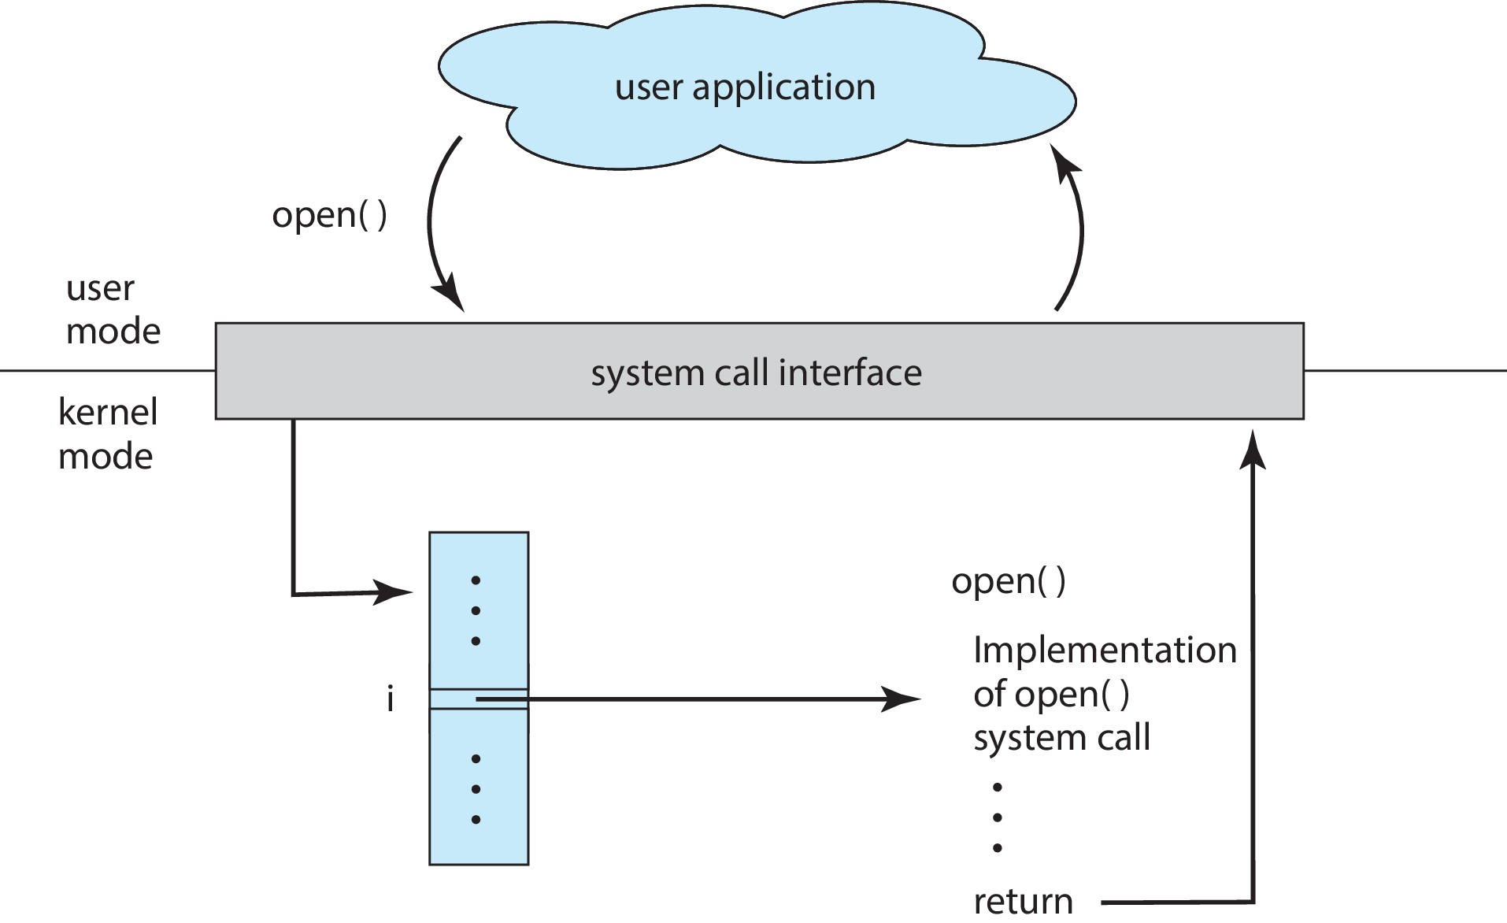
API – System Call – OS Relationship
Term | Meaning | Who Uses It
API (Application Programming Interface) | A set of functions that a programmer can use to build applications. | Application developer
System Call | The mechanism that allows an API function to request services from the operating system kernel. | API (indirectly)
Operating System (OS) | The core system software that manages hardware and provides low-level services. | Kernel-level code

Slide 56
System Call Processing
Three general methods are used to pass parameters between a running program and the operating system
Pass parameters in registers
Store the parameters in a table in memory, and the table address is passed as a parameter in a register
Push (store) the parameters onto the stack by the program, and pop off the stack by operating system

Slide 57
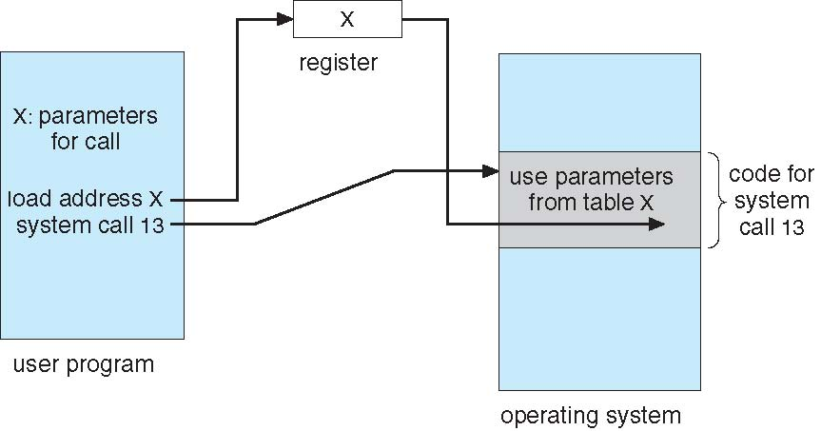
System Call Processing
Parameter Passing via Table

Slide 58
Types of System Calls
Process control
File management
Device management
Information maintenance
Communications

Slide 59
Types of System Calls
Process control
end, abort
load, execute
create process, terminate process
get process attributes, set process attributes
wait for time
wait event, signal event
allocate and free memory
Dump memory if error
Debugger for determining bugs, single step execution
Locks for managing access to shared data between processes

Slide 60
Types of System Calls
File management
create file, delete file
open, close file
read, write, reposition
get and set file attributes
Device management
request device, release device
read, write, reposition
get device attributes, set device attributes
logically attach or detach devices

Slide 61
Types of System Calls
Information maintenance
get time or date, set time or date
get system data, set system data
get and set process, file, or device attributes
Communications
create, delete communication connection
send, receive messages if message passing model to host name or process name
From client to server
Shared-memory model create and gain access to memory regions
transfer status information
attach and detach remote devices

Slide 62
Types of System Calls
Protection
Control access to resources
Get and set permissions
Allow and deny user access

Slide 63
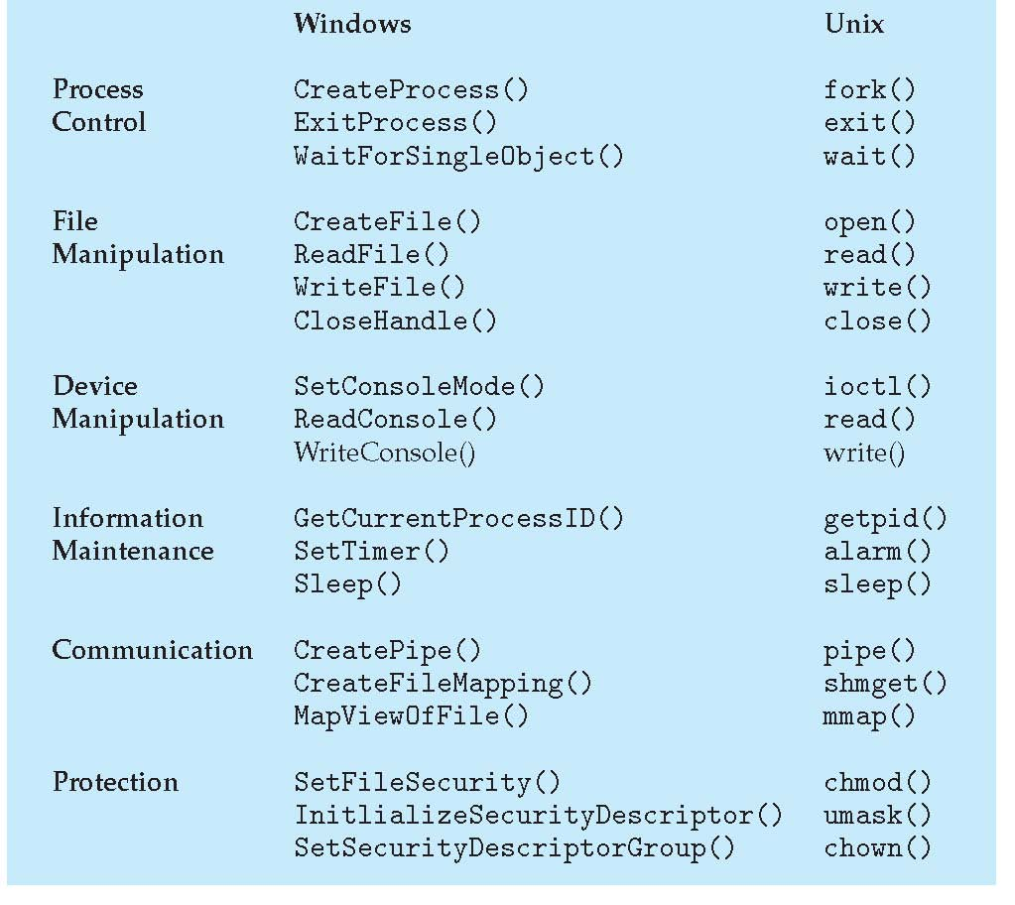
Examples of Windows and Unix System Calls

Slide 64
Interrupts

Slide 65
Interrupts
Mechanism by which hardware like I/O devices, memory modules may interrupt the normal processing of the processor
Interrupts are generated by various agents to notify the OS of the occurrence of some event
such as completion of an I/O activity
When an interrupt occurs, the execution flow of processor is diverted into specific part of OS code which deals with the event – interrupt handler
Interrupts are used to permit several programs and I/O activities to process independently and asynchronously
Hence improve the processing speed

Slide 66
Interrupts
Advantages
It provides a low overheads means of gaining the attention of the CPU
Interrupt Vector Table is a location near the bottom of memory contains the address of interrupt services procedures of I/O devices
As each instruction terminates, the processor may checks for the occurrence of interrupts
If an interrupt received, the actual program is temporarily suspended, and the processor is diverted to interrupt handling routine
When the interrupt is served, the execution will return to the interrupted program

Slide 67
Interrupts
Example:
External devices like printer are much slower than the processor
When processor is transferring data to the printer, the processor pause and remain idle until the printer is reading data
I/O modules will send an interrupt request signal to the processor to suspend its current processing and send more data

Slide 68
Interrupt Processing
Following events occurs in processor hardware and software due to an I/O interrupt
The device issue an interrupt signal to processor
The processor finishes execution of current instruction, saves states of interrupted process before responding to the interrupt
The processor sends an acknowledgment signal to the device that issued the interrupt and device remove its interrupt signal/flag
Processor transfer control to the appropriate interrupt handler routine and it starts processing interrupt
When the interrupt id served, the state of interrupted process is restored
Next process starts execution

Slide 69
Types of Interrupts
Interrupts may be generated by a number of sources, which are following
I/O:
Generated by I/O device controller, to signal normal completion of event or the occurrence of an error or failure condition
Time:
Generated by an internal clock within the processor due to expiration of a process’s time quantum or receipt of a signal from another processor on a multiprocessor system
Hardware error:
Generated by hardware faults such as power failure
Program:
Generated in a user program as a result of instruction execution, such as;
Arithmetic overflow
Divide by zero
Attempt to execute an illegal machine instruction
Reference outside a user allowed memory space

Slide 70


